Slide 1
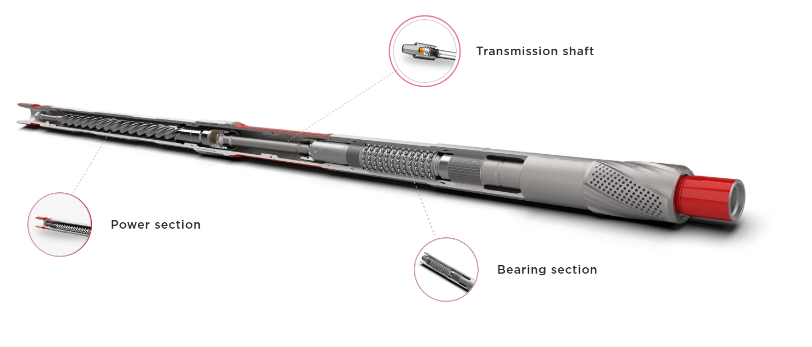
Welcome to the
9 5/8” Drillex Mud
Motor Services

Slide 2
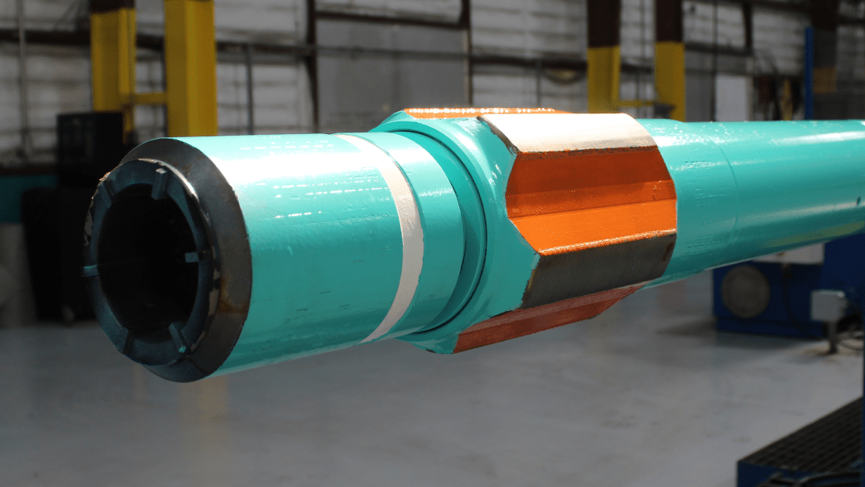
Drill Ex Mud Motor (9 5/8")

Slide 3
Drill Ex Mud Motor – 7:8 Lobe, 6.5 Stage Configuration
This technical presentation provides an analysis of Drill Ex Mud Motors which is configured with:
  7:8 Lobe Ratio — optimized for high torque output at reduced rotational speed
  6.5-Stage Power Section — designed to deliver balanced mechanical performance and differential pressure capacity.
Both motor configurations are engineered for use in 9-5/8″ borehole sections, typically encountered in surface and intermediate drilling intervals.
The comparison encompasses:
  Mechanical architecture
  Hydraulic performance envelopes
  Directional control suitability
  Operational trade-offs and field considerations
The objective is to support motor selection, application optimization, and performance risk assessment for large-diameter borehole operations.

Slide 4
Overview of 7:8 Lobe, 6.5 Stage Design
Feature | Purpose
7:8 Lobe Ratio | High torque output per pressure drop (low RPM)
6.5 Stages | Higher ΔP tolerance and torque capacity
Application | Large hole sections, hard formations, high WOB
Target RPM | 50–120 RPM
Stall ΔP | ~1000–1100 psi
Torque Range | ~18,000–21,000 ft-lbf

Slide 5
Mechanical Specifications
Parameter | Drill Ex Mud Motor | Drill Ex Mud Motor
Motor OD | 9.625″ (244 mm) | 9.625″ (244 mm)
Lobe Ratio | 7:8 | 7:8
Stages | 6.5 | 6.5
Flow Range | 700–1200 GPM | 650–1100 GPM
RPM Range | 50–120 RPM | 45–115 RPM
Max ΔP | ~1000 psi | ~950 psi
Torque Output | ~18,000–20,000 ft-lbf | ~19,000–21,000 ft-lbf
Stator Elastomer | NBR / HNBR | Proprietary high-temp elastomer
Rotor | Chrome-plated, helical | Ground & plated (tight tolerance)
Bit Connection | 7-5/8″ REG | 7-5/8″ REG

Slide 6
Performance Curves
RPM vs Flow:
  Drillex motor typically shows slightly lower RPM at the same flow due to tighter rotor/stator geometry
Torque vs ΔP:
  Both exhibit linear torque increase; Radius shows slightly steeper torque slope
Stall Pressure:
  Drillex: ~1050–1100 psi
  Drillex: ~1000–1050 psi
Efficiency:
  Radius slightly higher due to improved elastomer and bearing design

Slide 7
Design Features
Design Area | Drill Ex | Drill Ex
Rotor-Stator Fit | Tight, high interference | Precision-fit with advanced elastomer
Seal Design | Industry standard NBR/HNBR | Custom-developed sealing technology
Bearing Section | Standard heavy-duty | Enhanced cooling and load support
Length Profile | Moderate to long | Slightly more compact for 6.5 stages
Temperature Tolerance | Up to ~150°C (HNBR) | Potentially higher with proprietary elastomer
Field Serviceability | Field-repairable | Field-repairable (vendor-specific tools)

Slide 8
Application Suitability – Both Motors
Condition | Drill Ex 5:6 | Drill Ex 7:8
Hard Rock Formations | ✅ | ✅
High Torque at Low RPM | ✅ | ✅
Long Intervals (ERD) | ✅ | ✅
Thermal Stability Required | ⚠️ NBR limit ~120°C | ✅ Enhanced materials
High Dog-Leg Severity | ⚠️ Depends on BHA config | ✅ Tuned for directional systems
Bit Whirl / RPM Control | ✅ | ✅ Slightly better
Erosion Resistance | ✅ | ✅ (Elastomer-dependent)
✅ = Strong performance ⚠️ = Caution, may require configuration changes

Slide 9
Operational Considerations
Reliable in high torque conditions
Requires proper cooling and clean mud systems
May require torque limiting below stall ΔP for longevity
Best suited for WOB-intensive applications
Excellent thermal and wear resistance
Slightly better at directional stability
More RPM control due to geometry
Compatible with both motor steerable and RSS BHAs

Slide 10
Key Risks & Mitigations
Risk | Drill Ex | Drill Ex
Elastomer Swelling | Medium (if NBR used) | Low (proprietary blends)
Seal Fatigue | Moderate under high ΔP | Low to moderate
Torque Stall | At ~1100 psi | Slightly lower threshold
Wear / Erosion | Requires clean fluid | Same
Length Constraints | Watch for rig clearance | Slightly shorter in some builds
Mitigation: Use temperature-rated stators, monitor MWD torque/RPM, avoid solids buildup, and manage flow rates.

Slide 11
Summary & Recommendations
Drill Ex 7:8, 6.5 Stage:
✔️ Trusted performance
✔️ High torque output
⚠️ Slightly higher elastomer sensitivity
Drill Ex 7:8, 6.5 Stage:
✔️ Strong torque and directional response
✔️ Higher elastomer stability
⚠️ Slightly higher cost (typically)
Recommendation:
For thermal / extended runs, Radius offers a safer margin.
For WOB-focused or vertical high-load drilling, Titan delivers robust torque.
Choose based on well profile, temperature, and steering system compatibility.

Slide 12
Thank You For Staying With Us
Have A Nice Day and Work Safe

